Slide 1
Randomized Algorithms
Randomized Algorithms
Las Vegas Algorithm
Monte-Carlo Algorithm
Randomized Quick Sort
Primality Testing

Slide 2
Randomized algorithms
A randomized algorithm is just one that depends on random numbers for its operation
These are randomized algorithms:
Using random numbers to help find a solution to a problem.
Using random numbers to improve a solution to a problem.

Slide 3
Deterministic Algorithms
Input Output
Goal to prove that the algorithm solves the problem correctly always and quickly.
Typically the number of steps should be polynomial for the size of the input.
Algorithm

Slide 4
Randomized algorithms
Randomization. Allow fair coin flip in unit time.
Why randomize? Can lead to simplest, fastest, or only known algorithm for a particular problem.
Examples: Graph algorithms, quicksort, hashing, load balancing, Monte Carlo integration and cryptography.

Slide 5
Randomized Algorithms:
INPUT OUTPUT
RANDOM NUMBERS
In addition to input algorithm takes a source of random numbers and makes random choices during execution.
Random algorithms make decisions on rolls of the dice.
Ex : Quick sort, Quick Select and Hash tables.
ALGORITHM

Slide 6
Why Randomness?
Making good decisions could be expensive.
A randomized algorithm is faster.
Consider a sorting procedure.
5 9 13 8 11 6 7 10
5 6 7 8 9 10 11 13
Picking an element in the middle makes the procedure very efficient, but it is expensive (i.e. linear time) to find such an element.

Slide 7
Advantages of randomized algorithms
Simplicity.
Performance.
For many problems, a randomized algorithm is the simplest, the fastest, or both.

Slide 8
Scope of Randomized Algorithms:
Number theoretic algorithms: Primality testing, Monte Carlo etc.
Data structures: Sorting, order statistics, searching, computational geometry.
Algebraic identities: Polynomial and matrix identity verification. Interactive proof systems.
Mathematical programming: Faster algorithms for linear programming. Rounding linear program solutions to integer program solutions.

Slide 9
Scope of Randomized Algorithms Contd…
Graph algorithms: Minimum spanning trees shortest paths, minimum cuts.
Counting and enumeration: Matrix permanent. Counting combinatorial structures.
Parallel and distributed computing: Deadlock avoidance, distributed consensus.
Probabilistic existence proofs: Show that a combinatorial object arises with nonzero probability among objects drawn from a suitable probability space.

Slide 10
Randomized algorithms
In a randomized algorithm (probabilistic algorithm), we make some random choices.
2 types of randomized algorithms:
For an optimization problem, a randomized algorithm gives an optimal solution. The average case time-complexity is more important than the worst case time-complexity.
For a decision problem, a randomized algorithm may make mistakes. The probability of producing wrong solutions is very small.

Slide 11
Types of Random Algorithms
Las Vegas:
Guaranteed to produce correct answer, but running time is probabilistic.
Monte Carlo:
Running time bounded by input size, but answer may be wrong.

Slide 12
Las Vegas
Always gives the true answer.
Running time is random.
Running time is bounded.
Quick sort is a Las Vegas algorithm.
A Las Vegas algorithm always produces the correct answer. Its running time is a random variable whose expectation is bounded (say by a polynomial).

Slide 13
Monte Carlo
It may produce incorrect answer!
We are able to bound its probability.
By running it many times on independent random variables, we can make the failure probability arbitrarily small at the expense of running time.
A Monte Carlo algorithm runs for a fixed number of steps and produces an answer that is correct with probability ≥1/2.

Slide 14
Las Vegas VS Monte Carlo
Las Vegas Algorithm: It always produces the correct answer and the expected running time is finite (e.s.p. randomized quick sort).
Monte Carlo Algorithm: It may produce incorrect answer but with bounded error probability (e.s.p. randomized min_cut).

Slide 15
Routing Problem
There are n computers.
Each computer has a packet.
Each packet has a destination D(i).
Packets can not follow the same edge simultaneously.
An oblivious algorithm is required.
For any deterministic oblivious algorithm on a network of N nodes, for each of the node with an out degree d, there is an instance of permutation routing requiring (N/d) ^{½}.

Slide 16
Routing Problem Contd..
Pick random intermediate destination.
Packet i first travels to the intermediate destination and then to the final destination.
With probability at least 1-(1/N), every packet reaches its destination in 14n or fewer steps in Q_{n}.
The expected number of steps is 15n.

Slide 17
Randomized Algorithms Example
EXAMPLE: Expectation:-
X()------ flips a coin.
Heads: One second to execute.
Tails: Three seconds.
Let X be running time of one cell to X()
with probability 0.5------ X is 1.
With probability 0.5------X is 3.
Here random variable is X.

Slide 18
Randomized Algorithms Example
Expected value of X=E[X]=0.5x1+0.5x3= 2 seconds expected time.
Suppose we run X(),// take time X
X(),// take time Y
Total running time is T=X+Y , here T is random variable.
What is expected total time E[T]=?
Linearity of expectation: E[X+Y]=E[X]+E[Y]=2+2=4 seconds expected time.

Slide 19
Min_Cut Problem
Definition:
Min_cut Problem is to find the minimum edge set C such that removing C disconnects the graph.
Traditional Solution:
Max-flow: The maximum amount of flow is equal to the capacity of a minimum cut

Slide 20
Example of Min_Cut
a
b
e.g. Min_Cut = 2

Slide 21
Intuition
Let a graph G has n nodes and size of min_cut = k, that is |C| = k then : degree for each node >= k
total number of edges in G >= nk/2.
Randomized Min_Cut
Input: a graph G(V, E), |V| = n
Output: min_cut C
Repeat: Pick any edge uniformly at random, collapse it and remove self-loops
Until: |V| down to 2.
*Running time is O(n2)

Slide 22


Example of Randomized Min_Cut
min_cut = 2
Or maybe…
min_cut = 4

Slide 23
Randomized Algorithms - Examples
EXAMPLE: Hash Tables:-
Random hash code maps each possible key to randomly chosen bucket, but a keys random hash code never changes.
Good model for how a good hash code will perform:-
Assume hash table uses chaining , no duplicate keys.

Slide 24
Randomized Algorithms - Examples
Perform: find (k). K hashes to bucket b cost of search is one birr , plus birr for every entry in the bucket b whose key is not k.
Suppose there are n keys in table besides k.
V1,V2,………Vn : Random variables for each key Ki, Vi= 1 if key Ki hashes to bucket b , Zero otherwise.

Slide 25
Randomized Algorithms - Examples
Cost of find(k) is T= 1+V1+V2+……….+Vn.
Expectation cost is E[T]= 1+E[V1]+E[V2]+-------+E[Vn]
N buckets:- each key has 1/N probability of hashing to bucket b ≤ 0
E[Vi]=1/N
E[T]=1+n/N.
If load factor ≤ C,E[T]€ O(1).
Hash table operations take O(1) expected amortized time.

Slide 26
Deterministic Vs Randomized Algorithms
A deterministic algorithm is one that always behaves the same way given the same input; the input completely determines the sequence of computations performed by the algorithm.
Randomized algorithms, on the other hand, base their behavior not only on the input but also on several random choices.

Slide 27
Deterministic Vs Randomized Algorithms
The same randomized algorithm, given the same input multiple times, may perform different computations in each invocation.
This means, among other things, that the running time of a randomized algorithm on a given input is no longer fixed, but is itself a random variable.

Slide 28
EXAMPLE: Nuts and Bolts
Suppose we are given n nuts and n bolts of different sizes.
Each nut matches exactly one bolt and vice versa.
The nuts and bolts are all almost exactly the same size, so we can’t tell if one bolt is bigger than the other, or if one nut is bigger than the other. If we try to match a nut witch a bolt, however, the nut will be either too big, too small, or just right for the bolt.
Our task is to match each nut to its corresponding bolt.

Slide 29
Randomized Algorithms:
Two kinds of algorithms: deterministic and randomized.
A deterministic algorithm is one that always behaves the same way given the same input; the input completely determines the sequence of computations performed by the algorithm.
Randomized algorithms, on the other hand, base their behavior not only on the input but also on several random choices.
The same randomized algorithm, given the same input multiple times, may perform different computations in each invocation. This means, among other things, that the running time of a randomized algorithm on a given input is no longer fixed, but is itself a random variable.

Slide 30
EXAMPLE: Nuts and Bolts :
Finding the nut that matches a given bolt.
‘Uniformly’ is a technical term meaning that each nut has exactly the same probability of being chosen.
So if there are k nuts left to test, each one will be chosen with probability 1/k.
Now what’s the expected number of comparisons we have to perform? Intuitively, it should be about n=2, but let’s formalize our intuition.

Slide 31

EXAMPLE: Nuts and Bolts :
Let T(n) denote the number of comparisons our algorithm uses to find a match for a single bolt out of n nuts.
We still have some simple base cases T(1) = 0 and T(2) = 1, but when n > 2, T(n) is a random variable.
T(n) is always between 1 and n-1; it’s actual value depends on our algorithm’s random choices. We are interested in the expected value or expectation of T(n), which is defined as follows:

Slide 32
EXAMPLE: Nuts and Bolts :
Let T(n) denote the number of comparisons our algorithm uses to find a match for a single bolt out of n nuts.
We still have some simple base cases T(1) = 0 and T(2) = 1, but when n > 2, T(n) is a random variable.
T(n) is always between 1 and n-1; it’s actual value depends on our algorithm’s random choices. We are interested in the expected value or expectation of T(n), which is defined as follows:

Slide 33
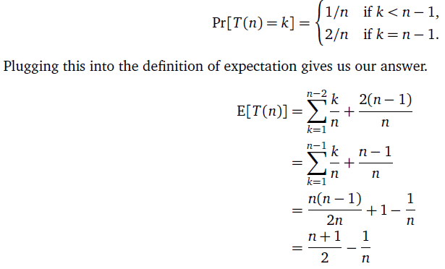
EXAMPLE: Nuts and Bolts :
If the target nut is the kth nut tested, our algorithm performs min{k, n-1} comparisons.
In particular, if the target nut is the last nut chosen, we don’t actually test it. Because we choose the next nut to test uniformly at random, the target nut is equally likely—with probability exactly 1/n—to be the first , second, third, or kth bolt tested, for any k. Thus:

Slide 34
EXAMPLES for Randomized Algorithms
Contention Resolution.
Global Minimum Cut.
Linearity of Expectation.
MAX 3-SATISFIABILITY.
Universal Hashing.
Load Balancing.
Randomized Divide-and-Conquer.
Queuing problems.

Slide 35
Las Vegas Vs Monte Carlo
A Las Vegas algorithm is a randomized algorithm that always gives the correct result but gambles with resources.
Monte Carlo simulations are a broad class of algorithms that use repeated random sampling to obtain numerical results.
Monte Carlo simulations are typically used to simulate the behaviour of other systems.
Monte Carlo algorithms, on the other hand, are randomized algorithms whose output may be incorrect with a certain, typically small, probability.

Slide 36
Las Vegas Example
Finding a Random point in circle.
It’s easy and convenient to compute a random point in a circle with a Las Vegas algorithm.
The idea is to first generate a point (x, y), with
-1 < x < 1 and -1 < y < 1. If this point happens to fall within the unit circle we keep it, otherwise we throw it away and try again.
This algorithm obviously gives the correct result, but it gambles with the number of calls to the random number generator.

Slide 37
Algorithm to find a Random point in circle
// Point returns a random point in the unit circle.
func Point() (x, y float64) {
for { // This loop runs 4/π times on average.
x = 2*rand.Float64() – 1;
y = 2*rand.Float64() - 1 ;
if x*x+y*y < 1
{ return
}
}
}

Slide 38
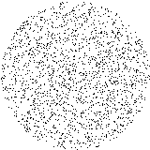
Circle with Points

Slide 39
Monte Carlo Algorithm Example
Finding the approximate value of π.
If points (x, y), with -1 < x < 1 and -1 < y < 1, are placed randomly, the ratio of points that fall within the unit circle will be close to π/4.
A Monte Carlo simulation would randomly place points in the square and use the percentage of points inside the circle to estimate the value of π.

Slide 40
Monte Carlo Algorithm Simulation
const n = 100000
count := 0
for i := 0; i < n; i++ {
x := 2*rand.Float64() - 1
y := 2*rand.Float64() - 1
if x*x+y*y < 1 {
count++
}
}
fmt.Println(4 * float64(count) / float64(n)) // 3.1484

Slide 41


Slide 42
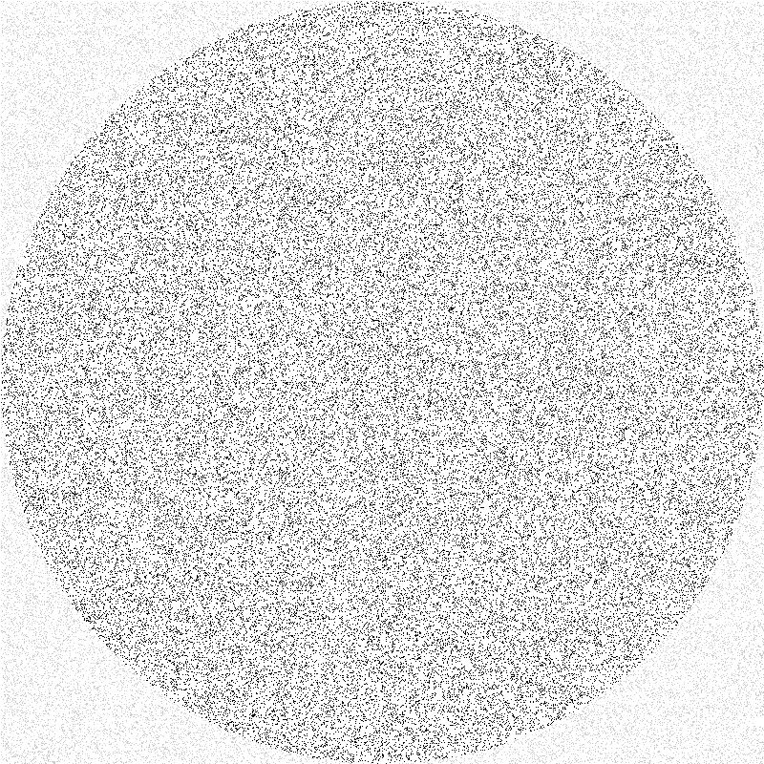

Slide 43
Quicksort Vs. Randomized Quicksort
Quicksort:
(A) Pick a pivot element from array
(B) Split array into 3 sub arrays: those smaller than pivot, those larger than pivot, and the pivot itself.
(C) Recursively sort the sub arrays, and concatenate them.
Randomized Quicksort:
(A) Pick a pivot element uniformly at random from the array.
(B) Split array into 3 sub arrays: those smaller than pivot, those larger than pivot, and the pivot itself.
(C) Recursively sort the sub arrays, and concatenate them.

Slide 44
Quicksort Vs. Randomized Quicksort
Quicksort can take O(n²) time to sort array of size n.
Randomized Quicksort sorts a given array of length n in O(n log n) expected time.
Randomization can NOT eliminate the worst-case but it can make it less likely!

Slide 45
Examples:
Quicksort algorithm is very efficient in practice, its worst-case running time is rather slow. When sorting n elements, the number of comparisons may be O(n²).
The worst case happens if the sizes of the sub problems are not balanced.
we prove that if the pivot is selected uniformly at random, the expected number of comparisons of this randomized version of Quicksort is bounded by O(n log n).

Slide 46
Randomized Quicksort
Alg. : RANDOMIZED-QUICKSORT(A, p, r)
if p < r
then q ← RANDOMIZED-PARTITION(A, p, r)
RANDOMIZED-QUICKSORT(A, p, q)
RANDOMIZED-QUICKSORT(A, q + 1, r)

Slide 47
A randomized algorithm to test whether a number is prime.
This problem is very difficult and no polynomial algorithm has been found to solve this problem
Traditional method:
use 2,3,… to test whether N is prime.
input size of N : B=log₂N (binary
representation)
=2^{B/2}, exponential function of B
Thus can not be viewed as a polynomial function of the input size.

Slide 48
Randomized prime number testing algorithm
Input: A positive number N, and a parameter m.
Output: Whether N is a prime or not, with probability of being correct at least 1-ε = 1-2^{-m}.
Step 1: Randomly choose m numbers b₁, b₂, …, b_{m}, 1≤ b₁, b₂, …, b_{m} <N, where m≥log₂(1/ε).
Step 2: For each b_{i}, test whether W(b_{i}) holds where W(b_{i}) is defined as follows:
(1) b_{i}^{N-1} ≠ 1mod N or
(2) ∃ j such that = k is an integer and the greatest common divisor of (b_{i})^{k}-1 and N is not 1 or N.
If any W(b_{i}) holds, then return N as a composite number, otherwise, return N as a prime.

Slide 49
Examples for randomized prime number testing
Example 1: N = 12
m = 3
Randomly choose three numbers between 1 and 12 in such a way that 1 <=b and b<12,
Let us take three numbers 2, 3, 7
2¹²⁻¹ = 2048 ≠ 1 mod 12
⇒ 12 is a composite number.
2048 / 12 gives the remainder 8.
Hence, the remainder is not equal to 1.
It implies that 12 is a composite number.

Slide 50
Example 2: N = 11
Randomly choose 2, 5, 7
(1) 2¹¹⁻¹=1024≡1 mod 11
j=1, (N-1)/2^{j}==5
GCD(2⁵-1, 11) = 1 Gcd(32,11) =1
W(2) does not hold . //2
(2) 5¹¹⁻¹=9765625≡1 mod 11
GCD(5⁵-1, 11) = GCD(3124, 11)
=11,
W(5) does not hold .
(3) 7¹¹⁻¹=282475249≡1 mod 11
GCD(7⁵-1, 11) = 1
W(7) does not hold .
Thus, 11 is a prime number with the probability of correctness being at least
1-2⁻³= 7/8 .

Slide 51
Randomized Quicksort
// Sorts an array arr[low..high]
randQuickSort(arr[], low, high)
1. If low >= high, then EXIT.
2. While pivot 'x' is not a Central Pivot.
(i) Choose uniformly at random a number from [low..high].
Let the randomly picked number number be x.

Slide 52
Randomized Quicksort Contd..
(ii) Count elements in arr[low..high] that are smaller than arr[x]. Let this count be sc.
(iii) Count elements in arr[low..high] that are greater than arr[x]. Let this count be gc.
(iv) Let n = (high-low+1). If sc >= n/4 and gc >= n/4, then x is a central pivot.

Slide 53
Randomized Quicksort
3. Partition arr[low..high] around the pivot x.
4. // Recur for smaller elements
randQuickSort(arr, low, sc-1)
5. // Recur for greater elements
randQuickSort(arr, high-gc+1, high)

Slide 54
Hoare Partitioning
Algorithm for random pivoting using Hoare Partitioning
partition(arr[], lo, hi)
pivot = arr[lo]
i = lo - 1 // Initialize left index
j = hi + 1 // Initialize right index

Slide 55
Randomized Quicksort
while(True)
// Find a value in left side greater than pivot
do
i = i + 1
while arr[i] < pivot

Slide 56
Randomized Quicksort
// Find a value in right side smaller than pivot
do
j = j - 1
while arr[j] > pivot

Slide 57
Randomized Quicksort
if i >= j then
return j
else
swap arr[i] with arr[j]
end while

Slide 58
Randomized Quicksort
partition_r(arr[], lo, hi)
r = Random number from lo to hi
Swap arr[r] and arr[lo]
return partition(arr, lo, hi)

Slide 59
Randomized Quicksort
quicksort(arr[], lo, hi)
if lo < hi
p = partition_r(arr, lo, hi) quicksort(arr, lo, p)
quicksort(arr, p+1, hi)

Slide 60
Randomized Quicksort
int main()
{
int arr[] = { 10, 7, 8, 9, 1, 5 };
int n = sizeof(arr) / sizeof(arr[0]);
quickSort(arr, 0, n - 1);
printf("Sorted array: \n");
printArray(arr, n);
return 0;
}

Slide 61
Randomized Quicksort
Sorted array:
1 5 7 8 9 10

Slide 62
Conclusion
Randomized Algorithms
Las Vegas
Monte Carlo
Randomized Quick Sort
Primality Testing

Slide 63
Thank You

